Slide 1
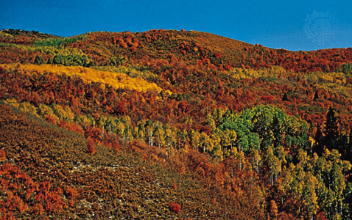
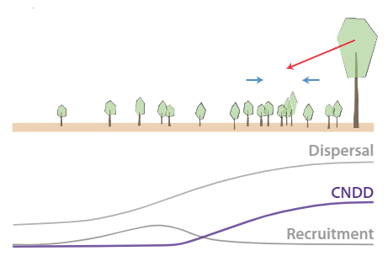
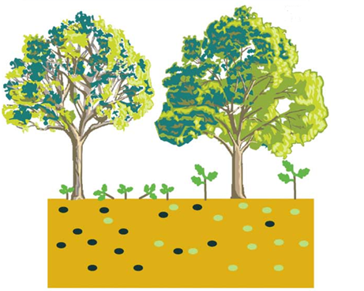
Density dependence in forest tree communities
Estimates of strength of density dependence
Seedling density →
Adult density →

Slide 2
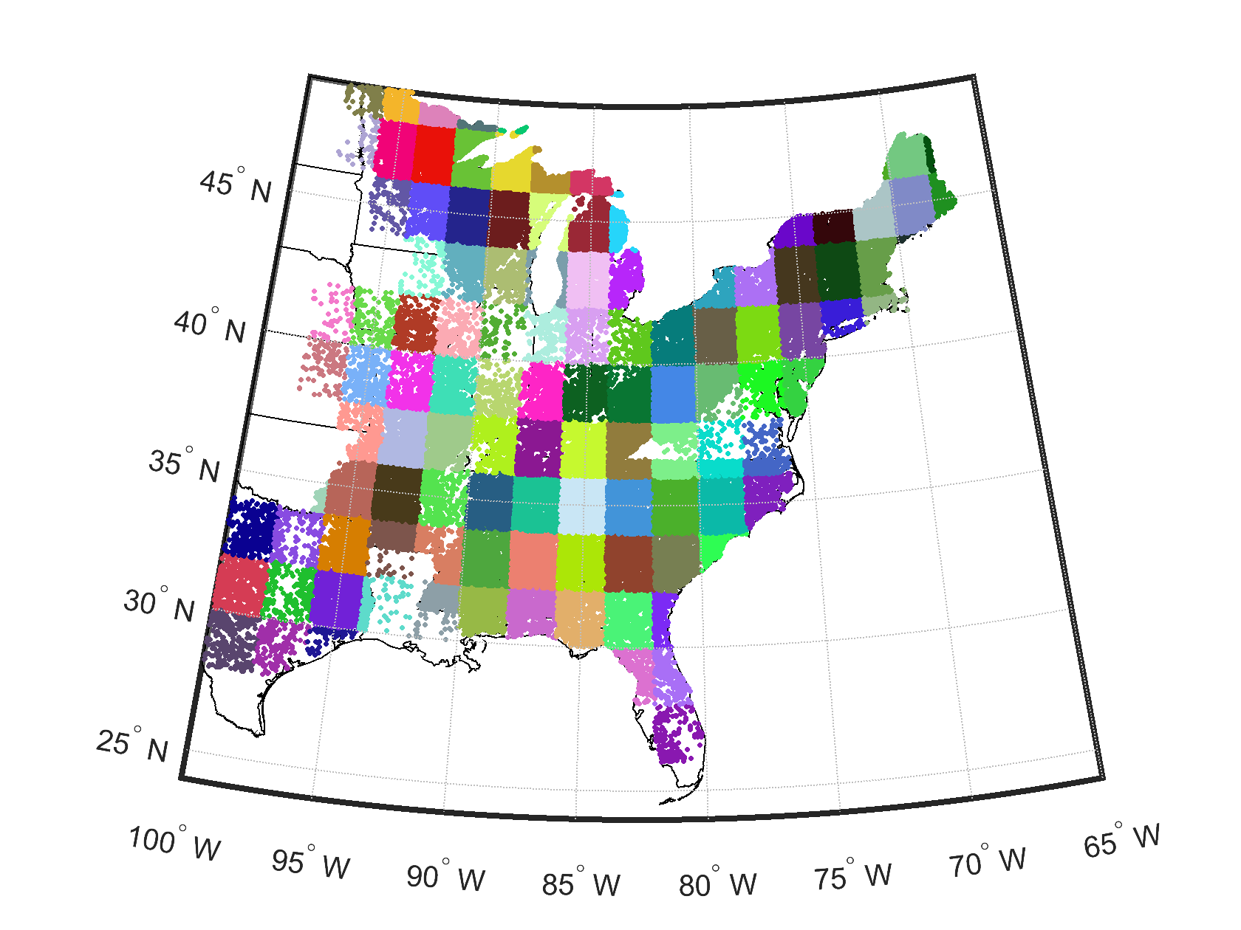
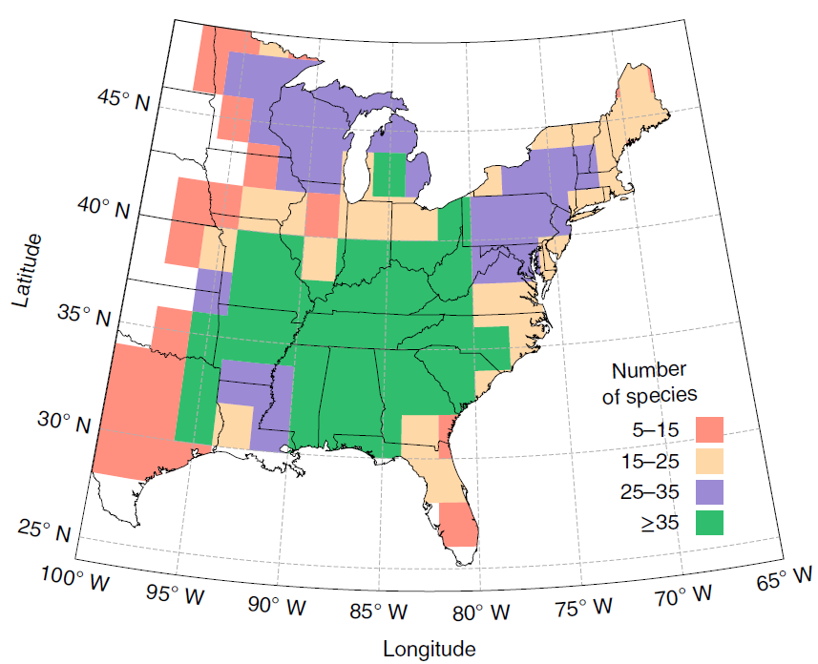
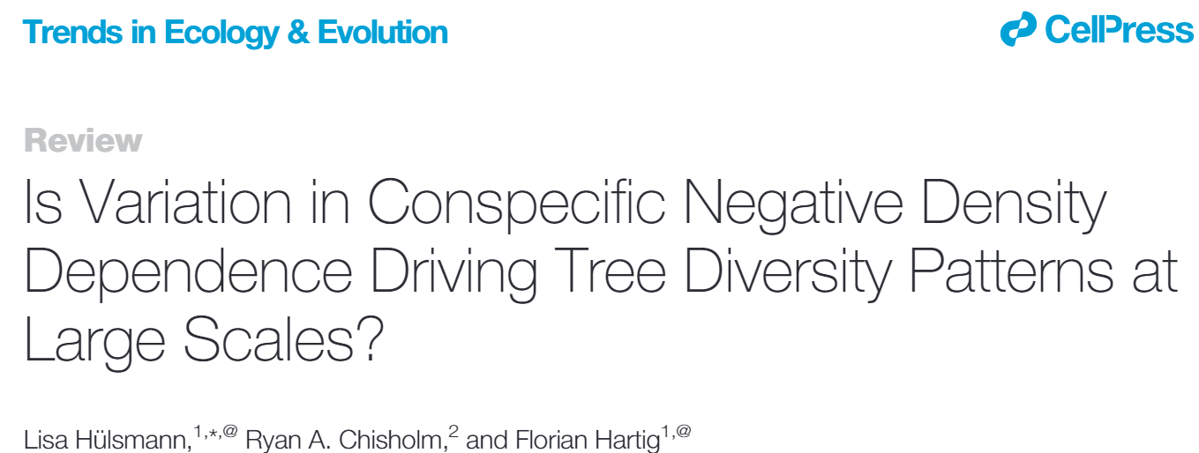
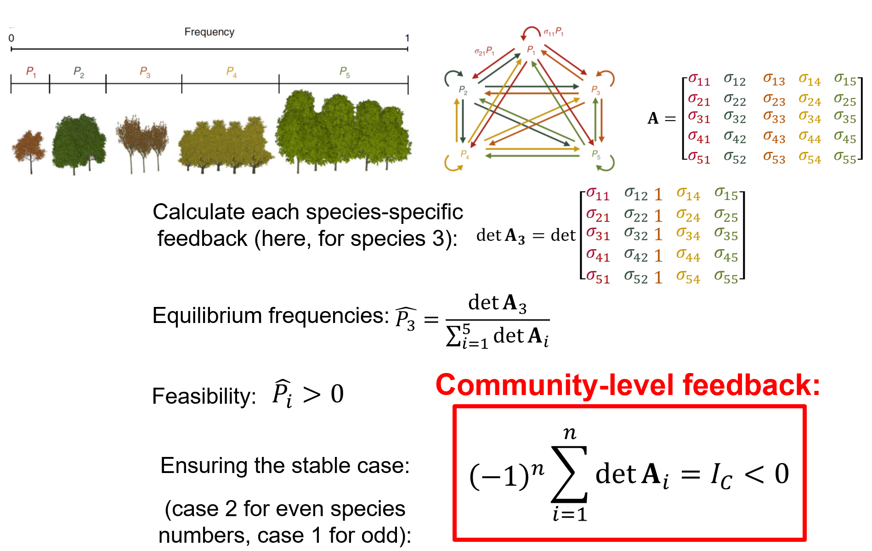
Density dependence in forest tree communities
Not so fast!! (Or not at all?)

Slide 3
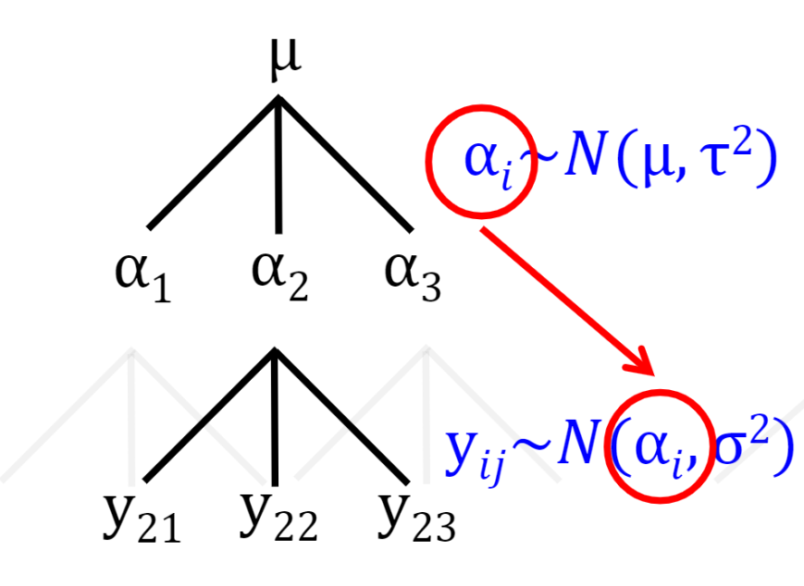
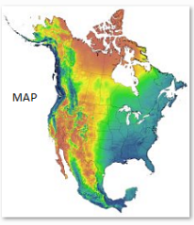
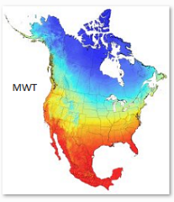
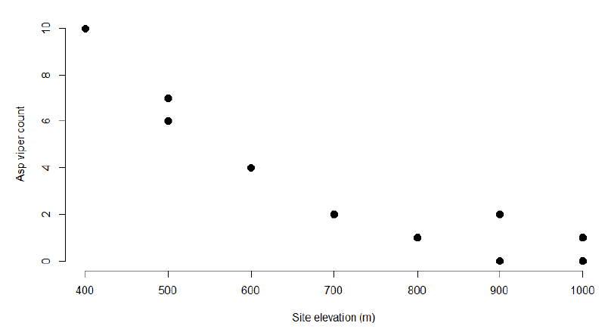
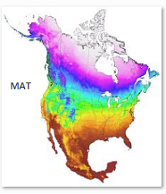
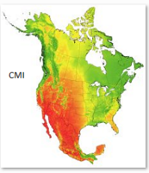
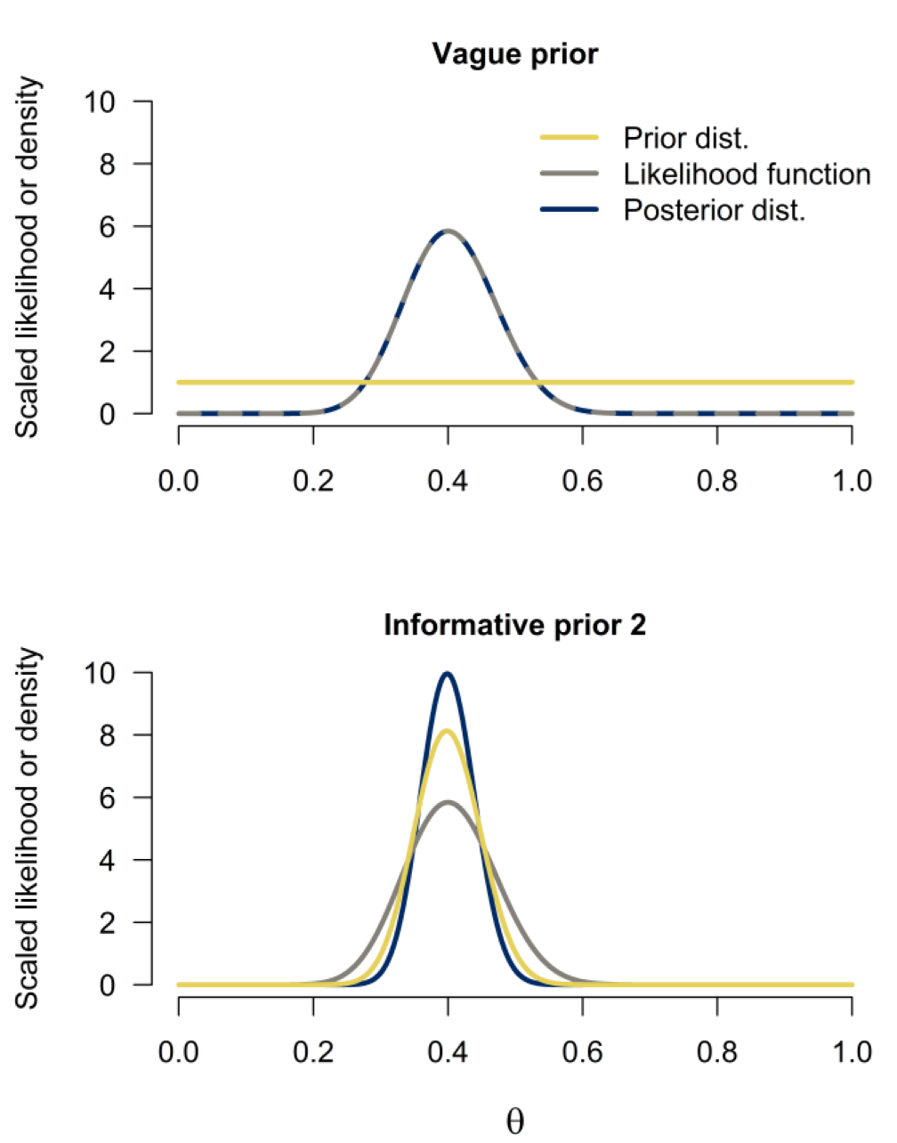
Some potential directions
Use subplots as replicates to estimate error in adult tree densities
Use climate data as co-variates, in one analysis of the full geographic range
Use data from experimental studies to inform priors

Slide 4
Folder contents on Github
Density dependence in forest tree communities
I) Link to Dataset: .txt file with 9 variables: 1) Latitude, 2) Longitude, 3) CellID, 4) PlotID, 5) subplot nr., 6) species nr., 7) # adults, 8) cumulative Basal area, 9) # seedlings.
1,564,261 rows
II) Readme file for the dataset
III) Brief project description, including references + links to the online .pdfs

